Slide 1
Eclipse for Science
How the Parallel Tools Platform can enhance the development of scientific applications

Slide 2

Parallel Tools Platform
Enabling Parallel Application Development
Best practice tools for experienced parallel programmers
Tools to assist new breed of programmers to develop parallel programs
parallel tools platform (ptp)
Improve parallel tools and the productivity of tool developers
Leverage Eclipse ecosystem and community for development and support
Provide focal point for parallel tool development for a broad range of architectures
2

Slide 3
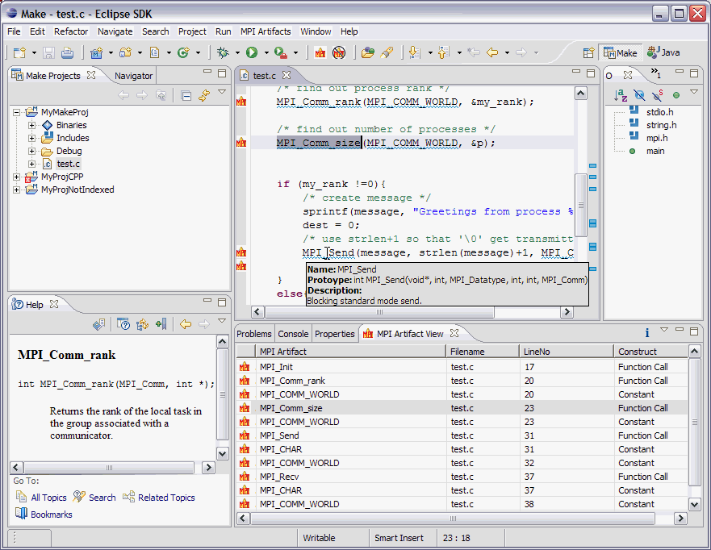
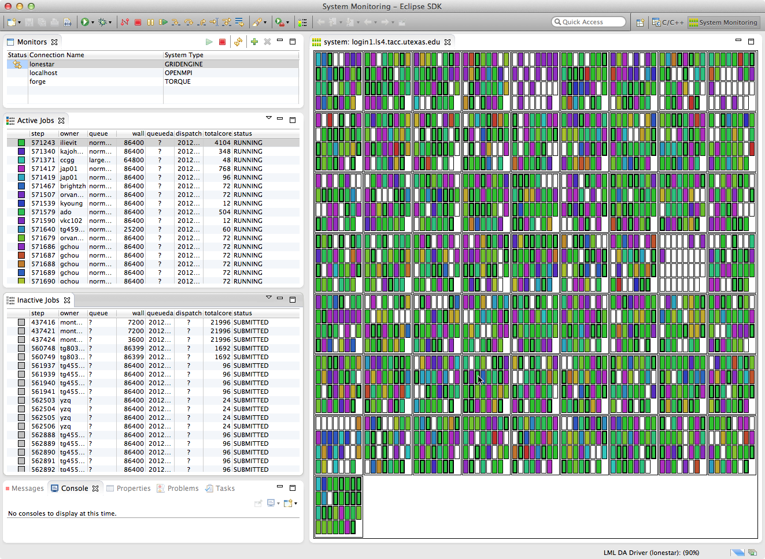
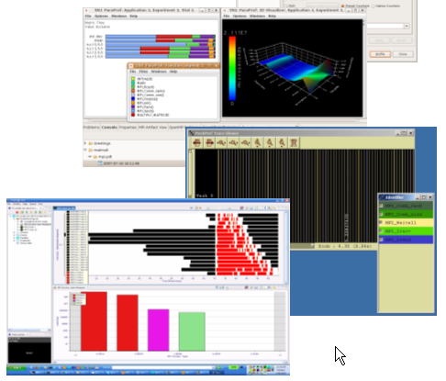
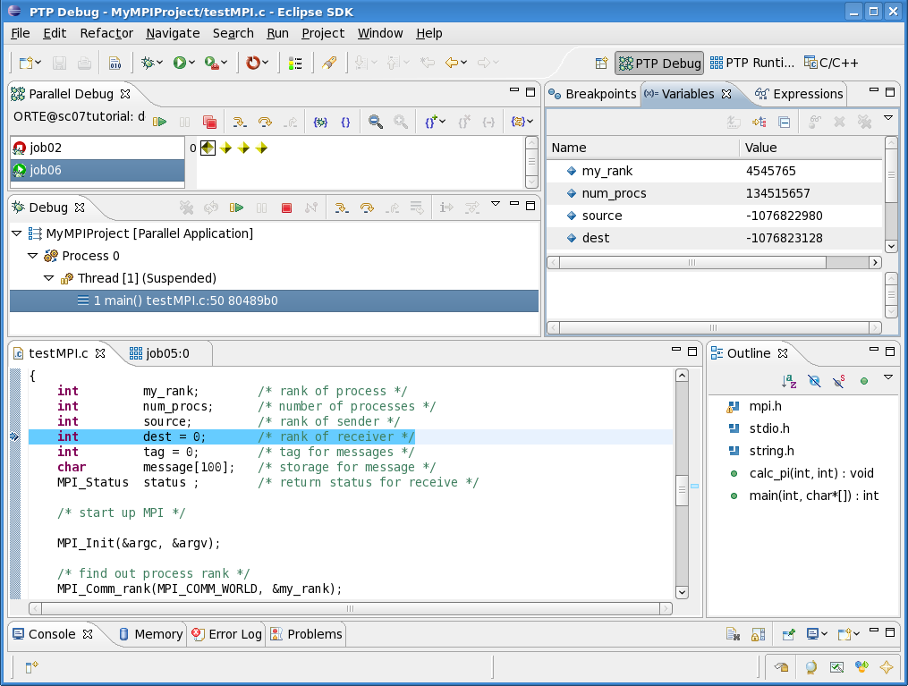
PTP Application Development Cycle
Coding & Static Analysis
Application Execution
Dynamic & Performance Analysis
Application Debugging
3

Slide 4
Coding & Static Analysis
Eclipse provides a wide variety of coding assistance tools
Project management, Editing and formatting, Navigation, Advanced searching, Refactoring, Version control
C/C++ Development Tools (CDT)
Standard (Makefile) and managed builders, Support for arbitrary toolchains, Visual debugging using GDB, High level views (outline view, call hierarchy, type hierarchy, include browser), Refactorings
Parallel Tools Platform (PTP)
Fortran, New project wizards (MPI, OpenMP) Content Assist, Hover help, Built-in API descriptions (MPI, OpenMP, LAPI, UPC), Location of parallel “artifacts” in code (MPI, OpenMP, PAMI, and UPC), Barrier analysis, Deadlock detection
Python Development (PyDev)
Code completion, type hinting, refactoring, debugging, interactive console, unittest, code coverage, Django integration
4

Slide 5
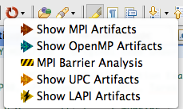
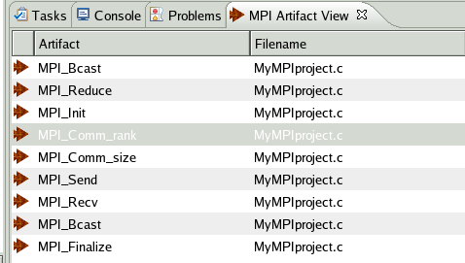
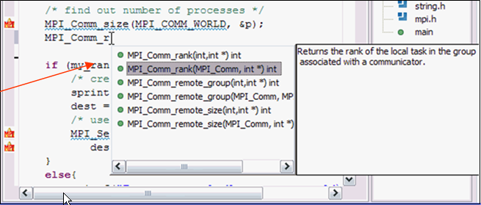
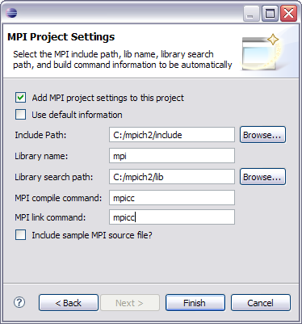

Coding & Static Analysis
Assistance tools to increase productivity of parallel programmers
New project wizards (MPI, OpenMP)
Content Assist (command/API completion), hover help, built-in API help descriptions in an html help “view” (MPI, OpenMP, LAPI, UPC)
Location of parallel “artifacts” in code: MPI, OpenMP, and UPC
5

Slide 6
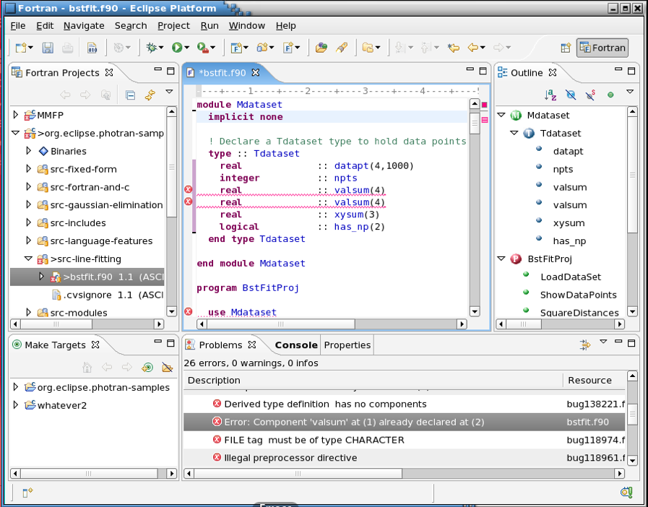
Fortran Development Tools
Photran features:
Supports Fortran 77-2008
Syntax-highlighting editor
GUI interface to gdb
Makefile-based compilation
Compiler error extraction
Outline view
Open declaration
Fortran refactorings
C preprocessor support
6

Slide 7
Python Development
PyDev is a Python IDE for Eclipse
Create/manage Python modules
Full array of Eclipse editing features for Python
Python debugger
Interactive console with Python interpreter
Integration with Python unittest and code coverage modules
7

Slide 8
PTP Application Development Cycle
Coding & Static Analysis
Application Execution
Dynamic & Performance Analysis
Application Debugging
8

Slide 9
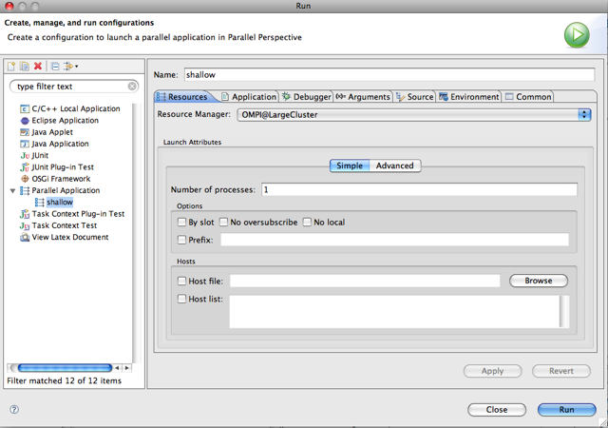
Application Execution
Launching & Monitoring
Improves visibility into target system
Single point of interface for launching and control
Manages interaction with different runtime systems and job schedulers
PBS/Torque
SLURM
Open MPI
LoadLeveler
MPICH2
PE
9

Slide 10
Application Execution
Target Configuration Framework
Extensible framework for launching & monitoring
System and node status information
Job status (e.g. position in queue) & application status
Job submission & control
Debugger launch
Configuration files to support different resource managers
Job schedulers (LoadLeveler, PBS, Torque, SLURM, GridEngine)
Interactive runtimes (e.g. PE, Open MPI, MPICH2, MVAPICH)
Systems (AIX, Linux, Power, x86, BG/Q, Cray)
Local or remote system support
Command-line tools executed locally or via ssh connection
10

Slide 11
PTP Application Development Cycle
Coding & Static Analysis
Application Execution
Dynamic & Performance Analysis
Application Debugging
11

Slide 12
Application Debugging
PTP Parallel Debugger
Mid-scale integrated debugger
Tightly integrated with Eclipse
Supports debugging multiple jobs simultaneously
Utilizes backend debugger (e.g. gdb) for low level operations
Targeted at SPMD programming models
Supports mixed MPI & thread debugging
Single process and group operations
Platform for building new debugging paradigms
12

Slide 13
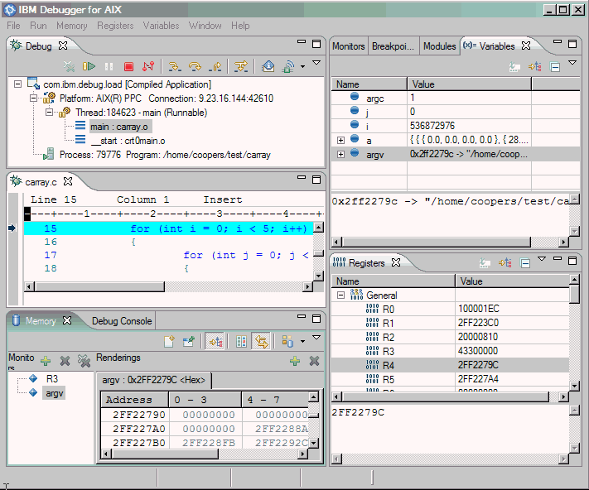
Application Debugging
Scalable debugger using multicast reduction network
Integrated with PTP and launched using target configurations
Supports basic debug commands
Uses gdb on backend
sdm master
sdm
sdm
sdm
gdb
gdb
gdb
gdb
gdb
gdb
gdb
gdb
gdb
process
process
process
process
process
process
process
process
process
13

Slide 14
PTP Application Development Cycle=
Coding & Static Analysis
Application Execution
Dynamic & Performance Analysis
Application Debugging
14

Slide 15
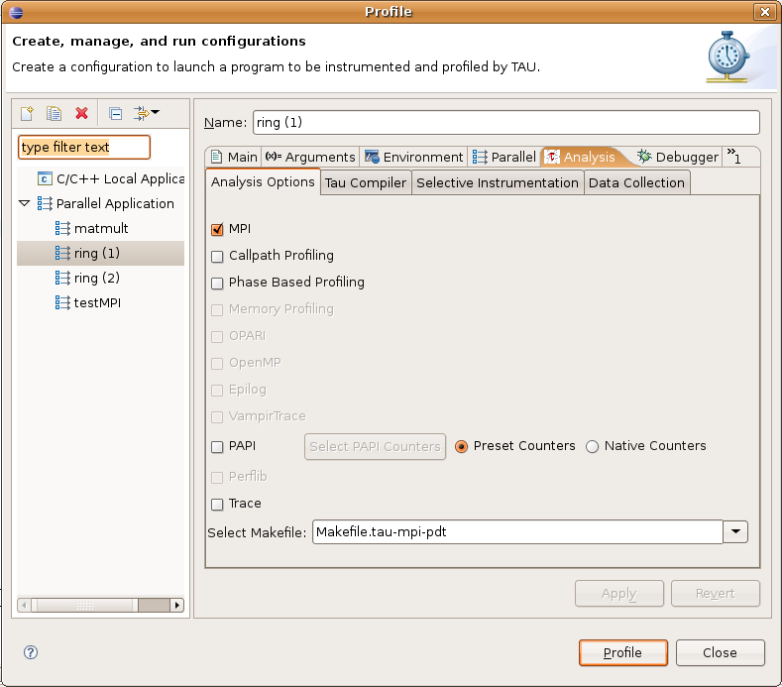
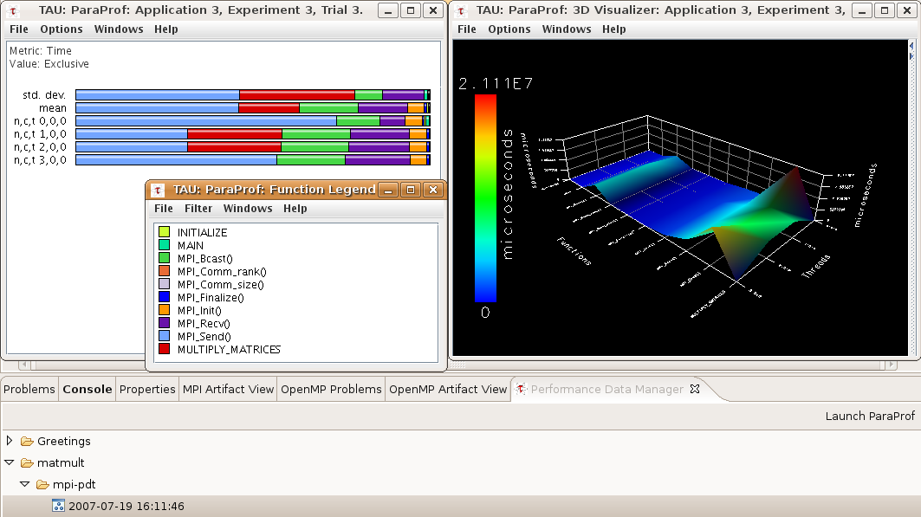
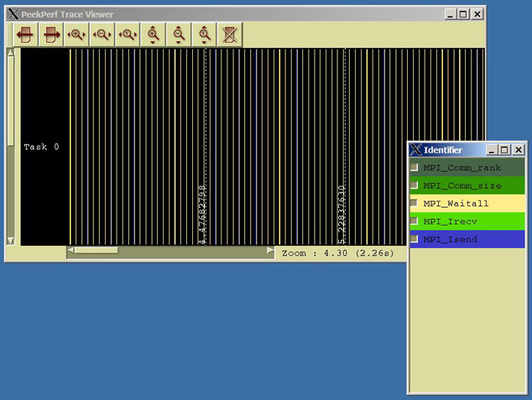
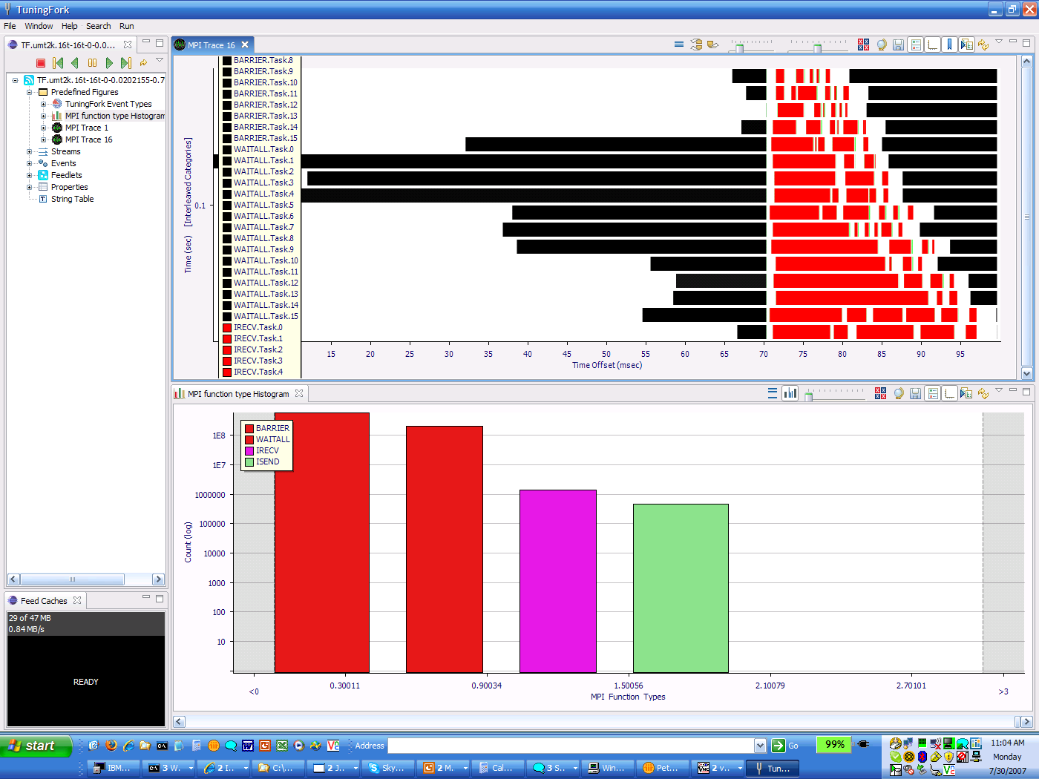
Dynamic & Performance Analysis
Dynamic Analysis Tools
Perform analysis on the running application using external tools
Generate results that must be brought back into Eclipse as part of the development workflow
May require external tool for visualization or other purposes
15
15

Slide 16
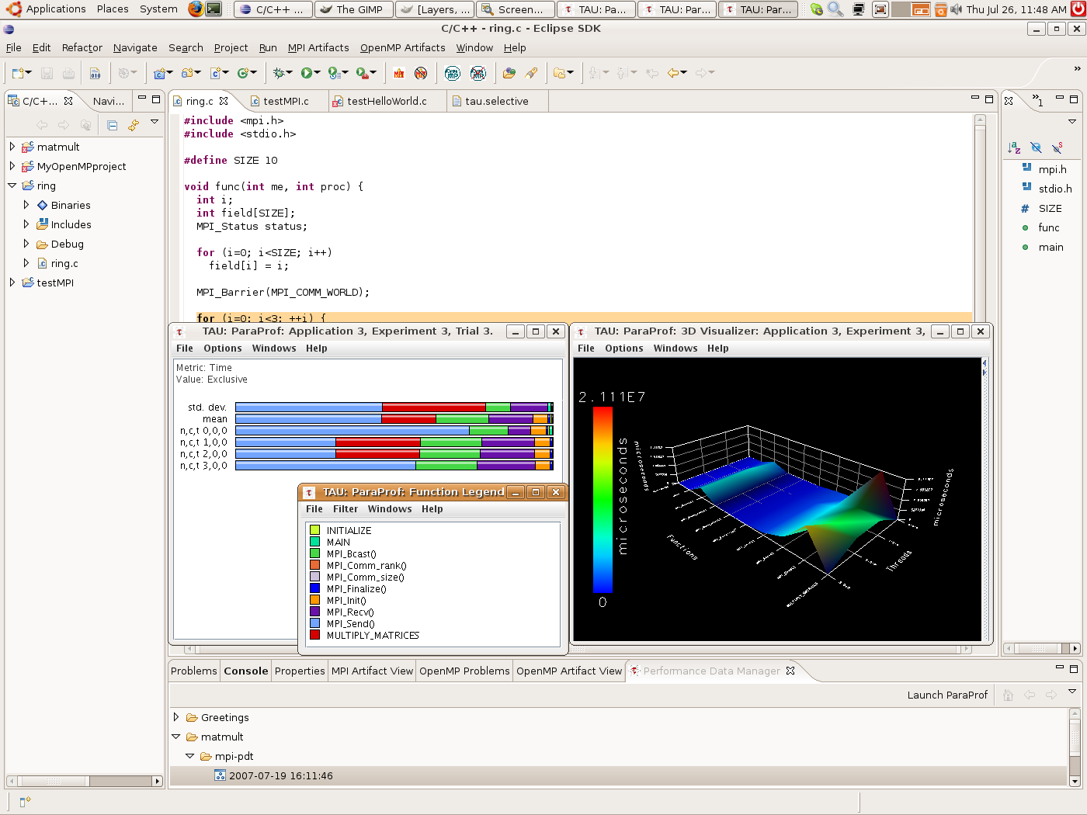
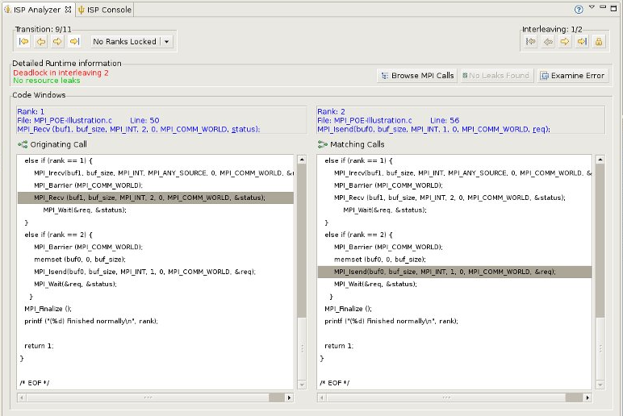
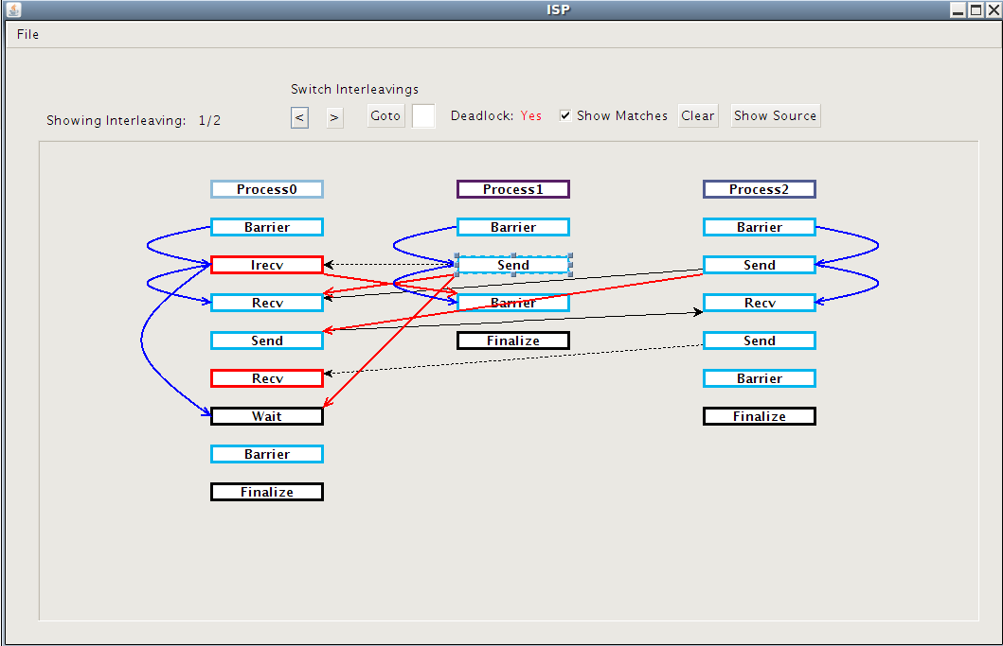
Dynamic & Performance Analysis
Tuning and Analysis Utilities (TAU)
Instrumentation and transparent re-build of application executable
Execution of profiled application and collect performance data
Performance data visible in UI
Launches paraprof visualization client from Eclipse
Graphical Explorer of MPI Programs (GEM)
Formal Dynamic Verification of MPI Applications
Detects all deadlocks, assert violations, MPI object leaks, and default safety properties
Matches sends and receives
Allows post-verification review of highlighted bugs
Works with a variety of MPI implementations
16

Slide 17
Online Information
Information about PTP
Main web site for downloads, documentation, etc.
http://eclipse.org/ptp
Developers’ wiki for designs, planning, meetings, etc.
http://wiki.eclipse.org/PTP
Articles and other documents
http://wiki.eclipse.org/PTP/articles
17

Slide 18
Community
PTP Mailing lists
Major announcements (new releases, etc.) - low volume
http://dev.eclipse.org/mailman/listinfo/ptp-announce
User discussion and queries - medium volume
http://dev.eclipse.org/mailman/listinfo/ptp-user
Developer discussions - higher volume
http://dev.eclipse.org/mailman/listinfo/ptp-dev

